Slide 1

Phonics and early reading at Fairfield first school

Slide 2
Our intent
*To provide a greater understanding of phonics and early reading
* Share insight into the changes of our phonics scheme and approach to reading.
* Explain how your child will read at school.
* Share ideas about how you can encourage a love of reading at home.

Slide 3
We have an irresistible belief that all children at Fairfield first school will become competent, successful and passionate readers.

Slide 4
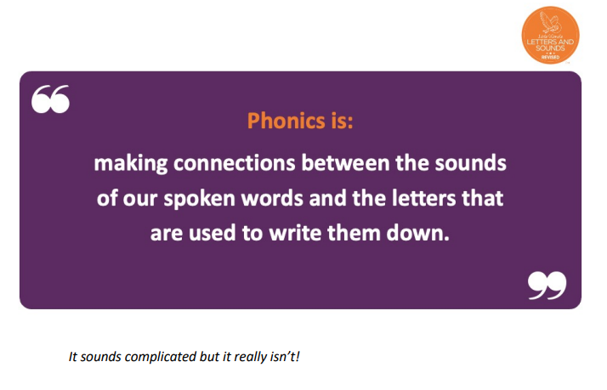
What is phonics?

Slide 5

What have we previously done?
Previously, we taught Phonics using the DfE Letters and Sounds document (2007) whilst supplementing the teaching with Jolly Phonics actions/songs and Singalong cursive.
Children would take home a colour banded or levelled reading book and change it often.
Very few of these books were phonetically decodable.

Slide 6
Why have we changed our approach?
We have not drastically changed our approach to teaching Phonics at Fairfield, we have read research and spent time looking at different approaches so that we can strengthen the way in which we teach Early reading.
Our decisions have been shaped by current research that has been undertaken on a National scale. We are passionate about ensuring our children learn using the most up-to-date strategies, approaches and beliefs. Our devotion to improving our practice to enable children to become successful readers is paramount.
Government guidance wishes schools to follow “validated” schemes to teach Phonics in order to ensure that Phonics teaching is consistent for all.

Slide 7
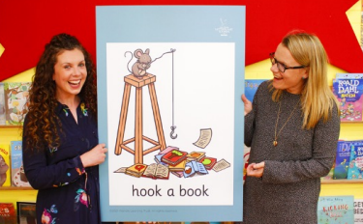
We have chosen little wandle letters and sounds Revised.
This is a Government validated scheme.

Slide 8
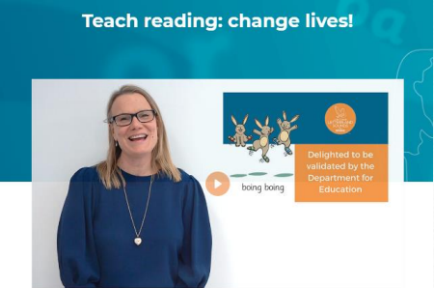
What is little wandle letters and sounds?
• An exciting, new DfE commissioned phonics scheme that puts emphasis on ensuring every child can read by the time they leave Year 1.
• It has new resources, fully decodable reading books, letter formation phrases.
• Built in ‘Keep Up’ sessions to ensure all children are supported.

Slide 9
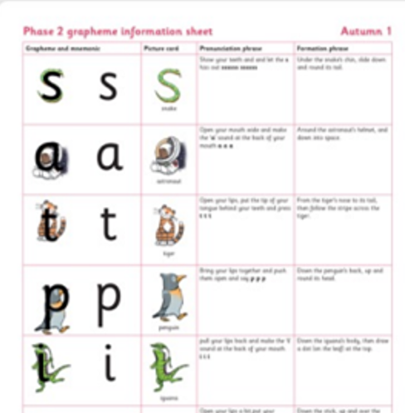
What does this look like when implemented at fairfield?
Phonics is taught everyday in Reception and Year 1 via discreet lessons.
Additional phonic sessions are delivered to specific children as part of our catch up plan.
Learning phonemes, digraphs and trigraphs are a route to decoding; to be able to blend to read and segment to spell.
These are learnt in ‘phases’ as a whole class.
4 new sounds are taught per week and a review lesson is delivered on a Friday. The order of the sounds can be found in your child’s reading planner.
After 5 weeks of teaching, the children are assessed on the sounds they have been learning, their blending skills, reading of words with key sounds and tricky words that have been introduced.
Children will par-take in 3 reading practice sessions every week with a teacher or teaching assistant.

Slide 10
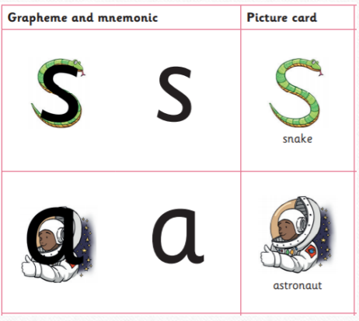
Phonic lessons
Children will learn new sounds using pictures to prompt them.
Each grapheme has a pronunciation phrase (e.g. Show your teeth and let the s hiss out ssssss ssssss) and a formation phrase (e.g. under the snake’s chin, slide down and round its tail)

Slide 11
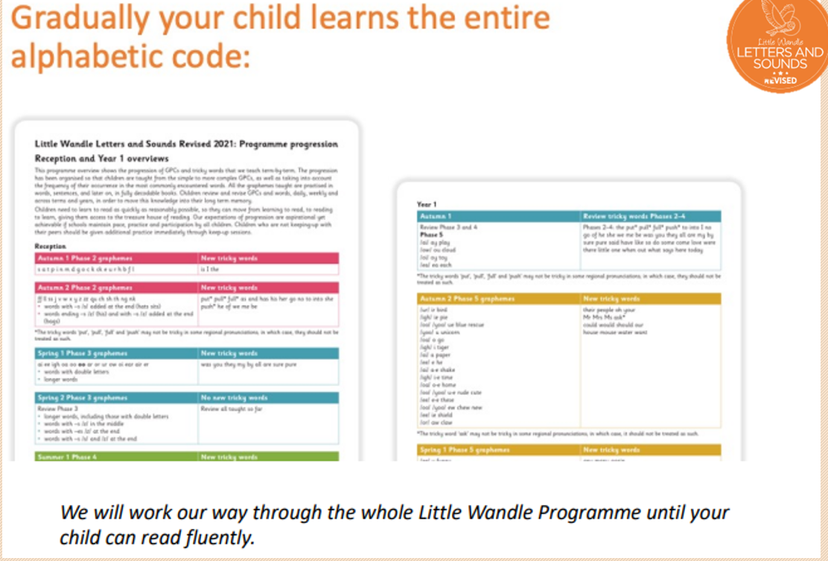

Slide 12

We teach children to read alternative sounds in year one

Slide 13

Children will be taught to spell words using all the different sounds.
All of these alternatives make the sounds SH!

Slide 14
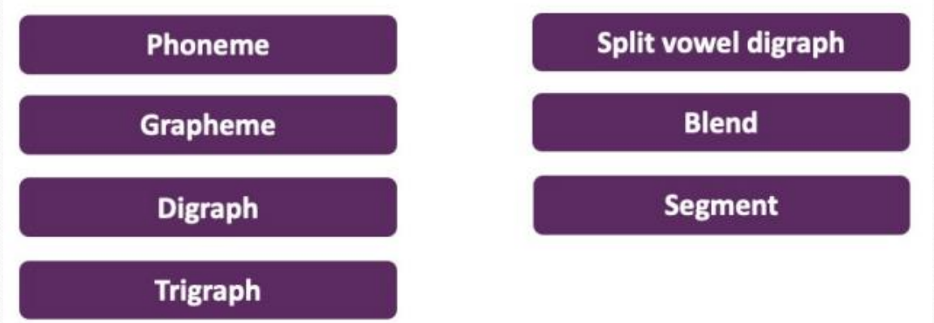
Key vocabulary!

Slide 15
Lets talk about reading….

Slide 16
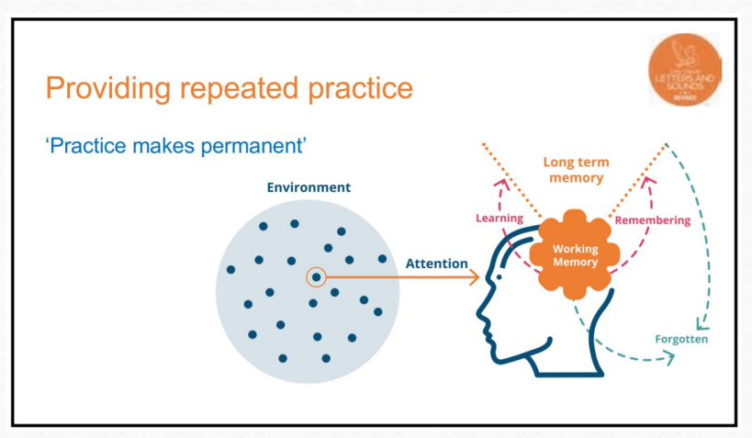
Children require 95% word understanding in order to have meaningful, comfortable comprehension.

Slide 17
The easiest way to sum it up -
The aim and over-riding objective is to strive for fluency.
That means children should not be blending every single word!
They should be able to read a book with 90% fluency.
FLUENCY IS KEY!

Slide 18
Reading practice sessions
Children will read 3 times per week to a teacher/ta during school time. They will read the same book focusing on different skills: -Decoding (blending), Prosody (expression) and Comprehension (understanding)
They will be able to access the book shared at school and online at home. They can repeat this book at home and “showcase” how they can read the book to parents and carers.
This book is matched to your child’s phonic ability and their reading should be fluent and automatic. The aim is that the children read at a 90% fluency. This means that the children should need little to no support reading the words. We assess them every 6 weeks to match their reading ability to the right book. They will also visit the school library once a week to choose a book that they can bring home and share.

Slide 19
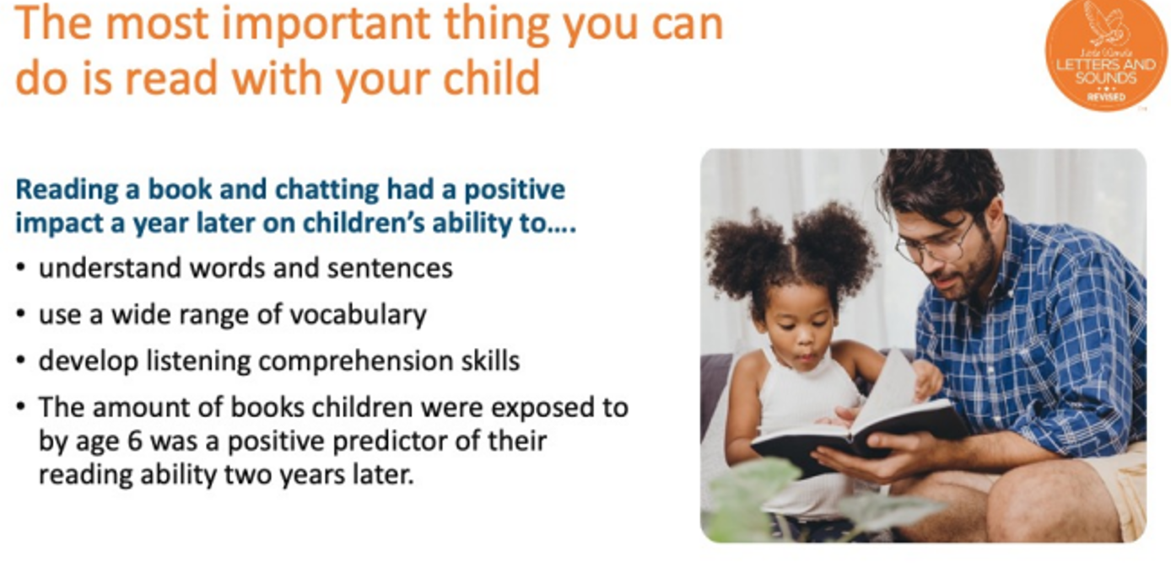

Slide 20
Helping your child at home
Please make sure you know how to pronounce the sounds! You can find a direct link for this on the Oak and Beech class website.
Promote a love of reading both with the decodable book and the sharing (library) book. Read to your child, ask questions, visit the library, buy books for birthdays and Christmas, clarify the meaning of words, role-play characters, discuss the pictures, predict what might happen next. Make reading a fun experience!
Celebrate their success and achievements with reading.

Slide 21
Additional support -
https://www.littlewandlelettersandsounds.org.uk/resources/for-parents/
Visit the link above for parent resources and support.
If you have questions, comments or need any help with anything please speak to a designated member of staff. Staff are here to support you tonight.

