Slide 1
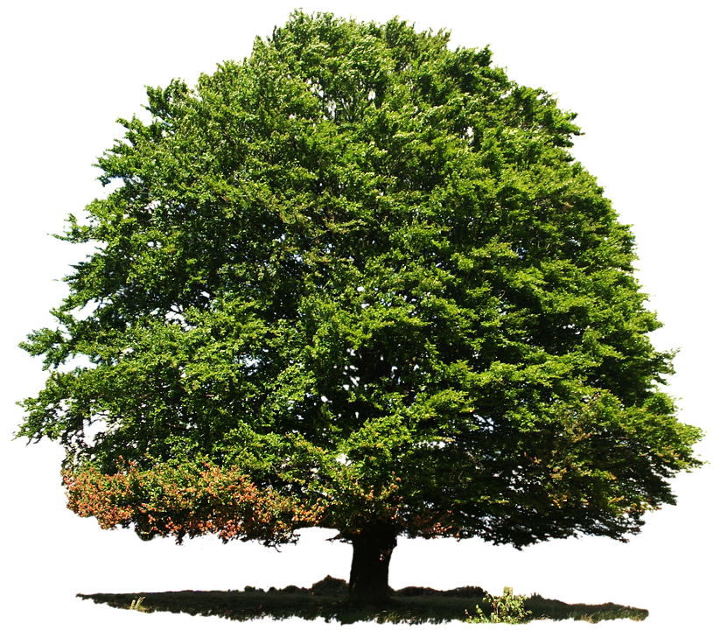
Welcome to Beech Class
Parent Curriculum Information Evening.
Mrs Thurston
Mrs Southam
Mrs Vine

Slide 2
In Beech Class we learn the following subjects:
English
Mathematics
Science
Computing
History
Geography
Art
PE
Design Technology (DT)
RE
Music
Learning Outside the Classroom (LOTC)
PSHE and Citizenship

Slide 3
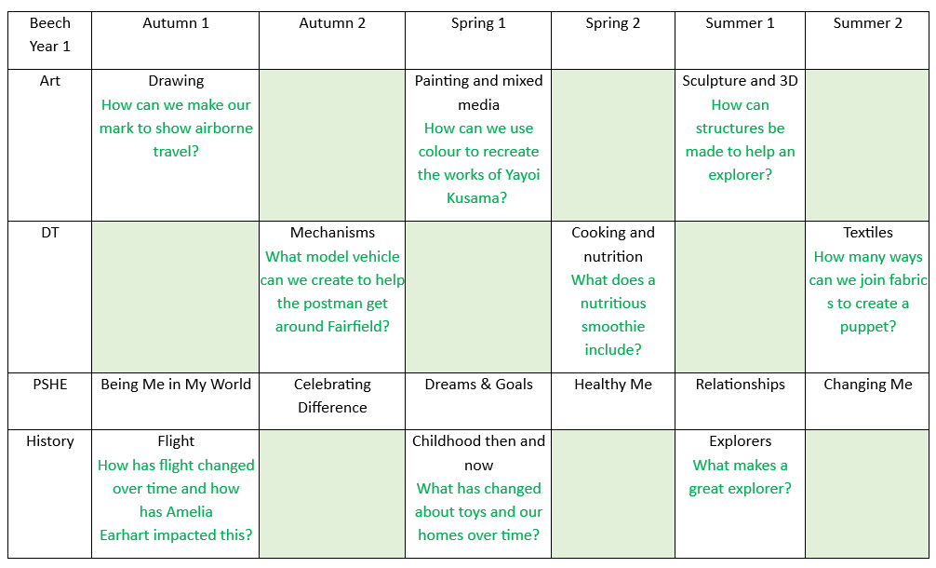

Slide 4
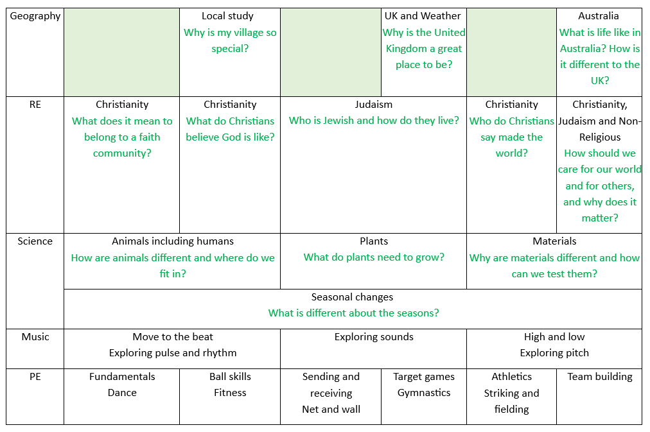
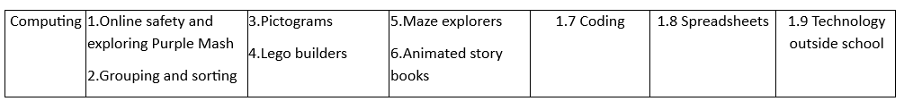

Slide 5

Important information for parents
Children in Year One will take a National screening test to assess their phonic knowledge towards the end of the academic year.
Test is 1 to 1 with teacher.
Contains 40 words, 20 real words and 20 nonsense words.
Children will need to blend these words.
This Photo by Unknown Author is licensed under CC BY-NC-SA

Slide 6


Slide 7


Every Wednesday, log in to Collins E books.
Your child will be allocated a book.
They should be reading this fluently without overly blending.
Also we will visit the library every FRIDAY.

Slide 8
Benefits of reading to your child
Reading provides a wonderful opportunity for you and your child to connect. ...
Listening skills. ...
Expanded vocabulary. ...
Attention span. ...
Creativity. ...
Life lessons. ...
Social and emotional development.

Slide 9
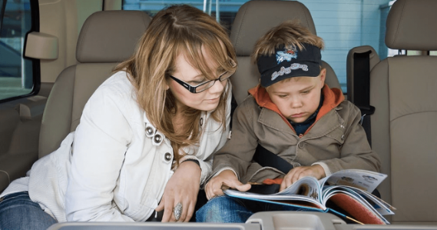
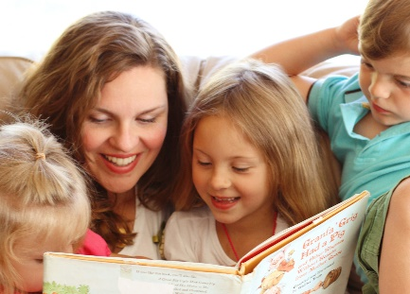
Tips for reading
Be consistent.
Take your time.
Make it fun.
Point out connections.
Don’t stop with books.
Ask question.

Slide 10
School reminders
No jewellery to be worn including watches.
Hair needs to be tied up with green/black accessories.
Dark socks (black/grey) to be worn only.
If your child has pierced ears, earrings must be silver/gold studs for school and they MUST have them covered for PE lessons, for health and safety reasons.
Please ensure your child has a named water bottle in school daily.
Children to have bookbags in school every day.
Remember to name new items of clothing.
Regularly check Google Classroom.
Make sure coat is in school everyday.

Slide 11

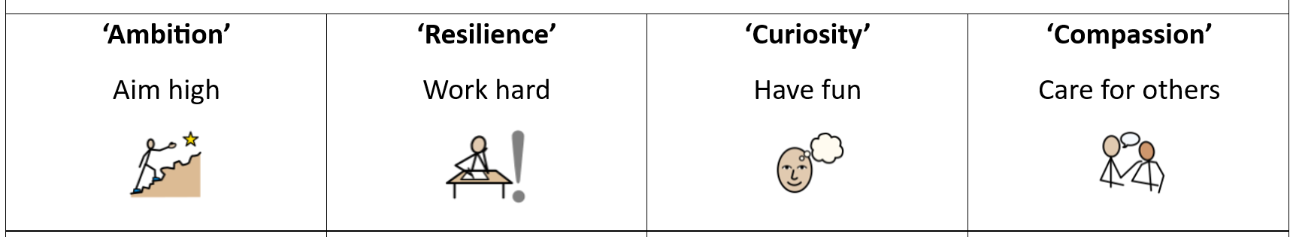

Slide 12
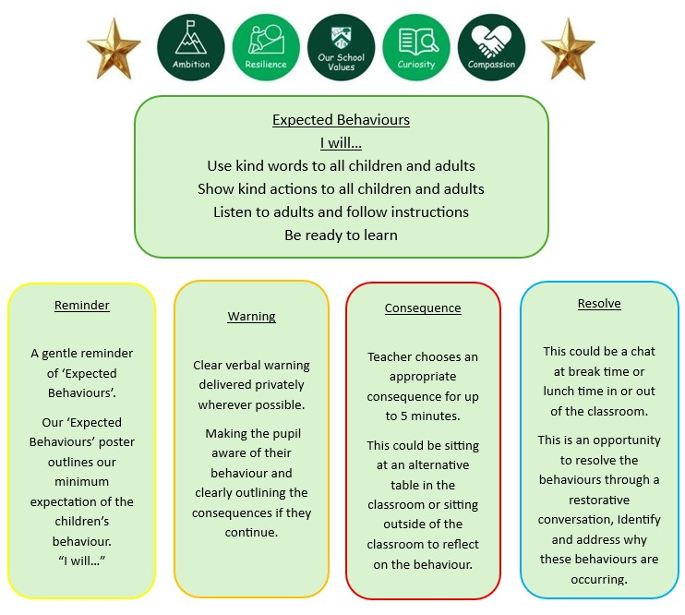

Slide 13
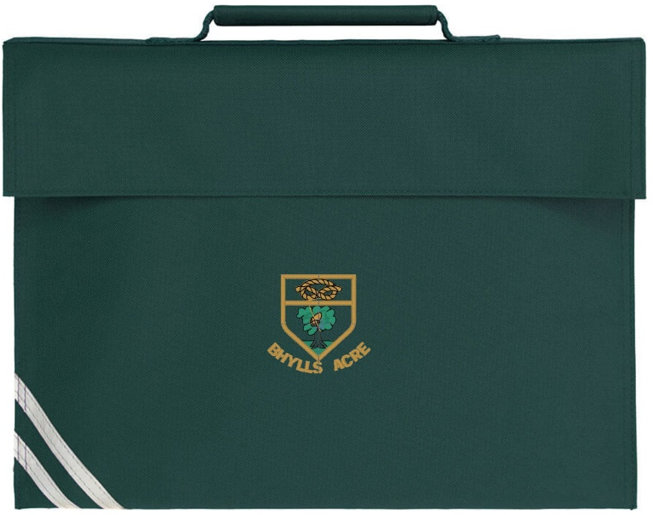

Book bags….
These will be left in your child’s drawer during the day.
Only need to contain your child’s shared book and reading record.
Need checking regularly for important items.

Slide 14
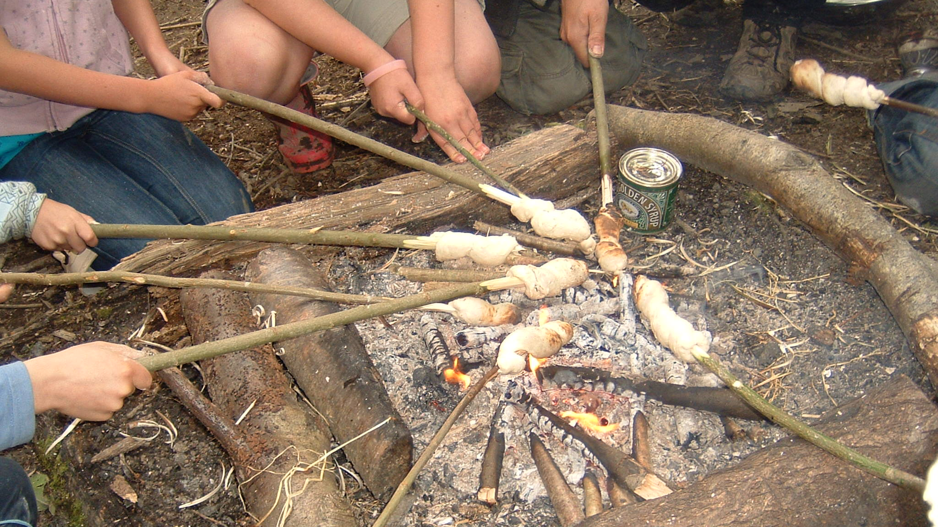
Forest school…
Will be on a WEDNESDAY MORNING.
Come wearing forest school clothes.
Bring bag with waterproofs and gloves.
Place bag in pigeon holes before children line up and collect at the end of day.
Please bring book bag on Wednesday.
Bring a separate coat for playtime.
This Photo by Unknown Author is licensed under CC BY-SA

Slide 15
Homework:
Will be in the form of topic related projects. Children will be given a couple of weeks to do them. Encouraging families to work together.
Children should read or share a book AT LEAST 4 TIMES A WEEK.
Also activities will be set on Numbots and Purple Mash on a regular basis. Children will be given a card with all their passwords on.
Maths KIRFS each half term.
Phonic review sheet every week and new sound on GC every day.

Slide 16
Health and Wellbeing
This is a top priority in school.
We will be doing lots of activities to encourage mindfulness.
Wellbeing Wednesday and Wellbeing Warriors
Encourage children to share worries and concerns.

Slide 17

Formality and fun
Although we have different learning methods, we will be having lots of fun in Beech class and learn in a practical and hands-on approach.
Children are encouraged to be independent learners.
Good listening is vital.
High expectations for behaviour.
Effective parent/school partnership is essential. Open communication.

Slide 18

Keep up to date with school life…
Instagram
Newsletter
Website

Slide 19

Any questions?
We pride ourselves on good communication and although things have changed; we encourage you to let us know of any questions, concerns or worries by emailing or calling the office.

Slide 20

Thank you
Your time is greatly appreciated!
“Children who enjoy school aged 6 tend to get better grades 10 years later”
This Photo by Unknown Author is licensed under CC BY-NC-ND

