Slide 1
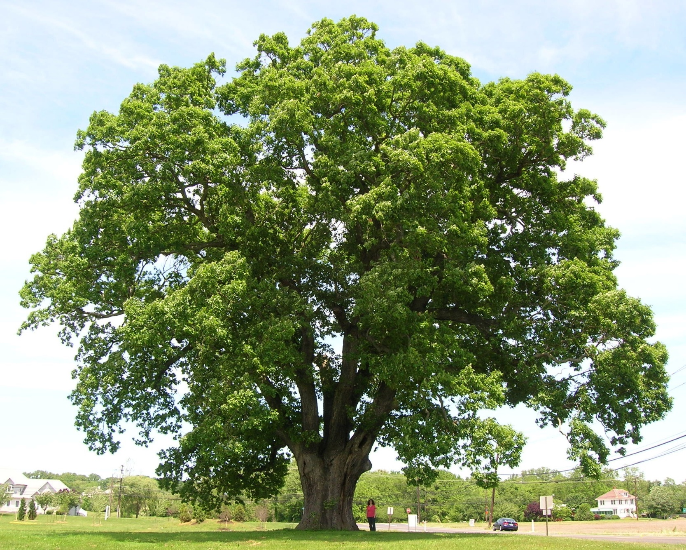
Welcome to Oak Class

Slide 2
Welcome to Oak Class
We are:
Mrs Hill
Mrs Wilkes
Mrs Stevens

Slide 3

Our Curriculum
EYFS – 7 areas of learning

Slide 4
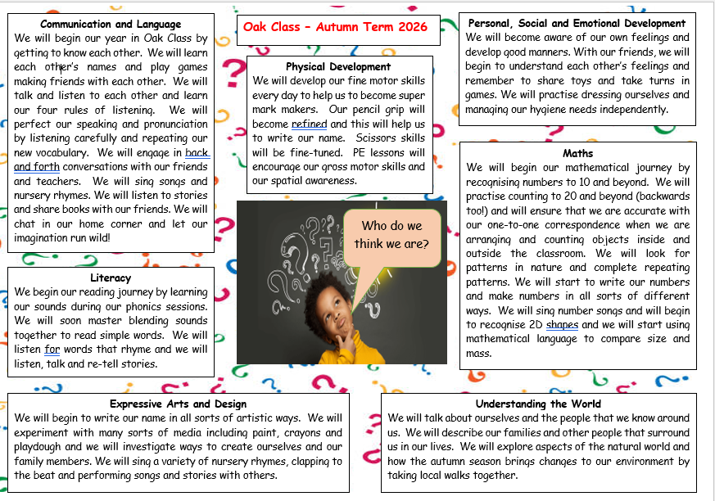

Slide 5
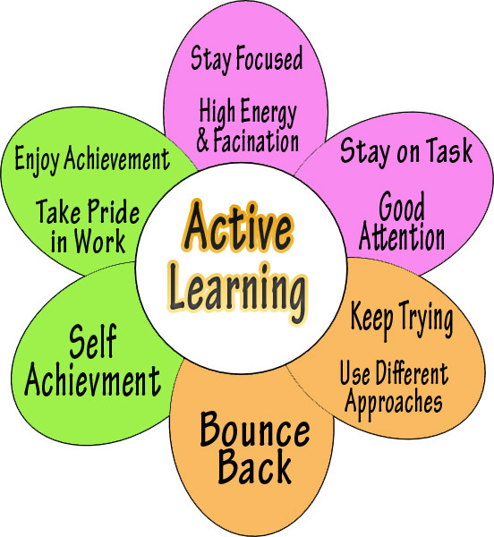
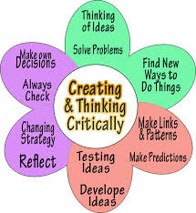
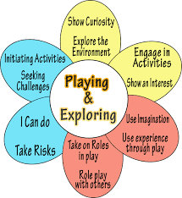
Characteristics
of effective learning

Slide 6


START of the day
Bring your child to the door outside Oak class, ready for the bell to ring at 8.45am.
Siblings can come in with them and go to their own classroom via our door, or line up in their own class line for 8.45am.

Slide 7
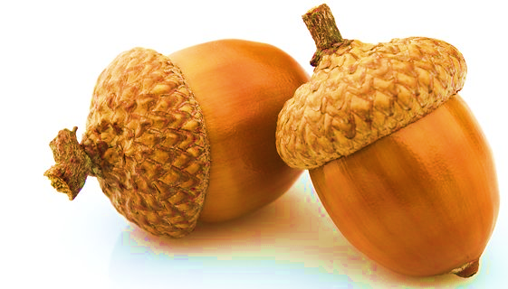
Typical day in Oak class
WELCOME CHILDREN TO SCHOOL
8.45 – Welcome children, register, assembly.
Reading practice.
Finger gym/ Phonics/ Free-play.
10.15 Play time
10.30 Snack time
10.45 Story/singing time/Topic/PE
12:00 – Lunchtime.
1:00 – Listening games.
1:20 – Maths/Forest School
and free play (indoors and outdoors)
2:45 – Story/circle time
3.15 – Home time

Slide 8

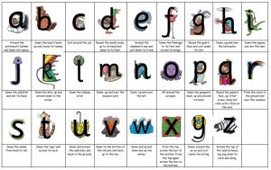
READING -Phonics
Phonics is a method for teaching reading and writing to children.
To use phonics is to teach the relationship between the sounds of the spoken language (phonemes) and the letters or groups of letters of the written language (graphemes).
At Fairfield, we follow the Little Wandle Letters and Sounds scheme to teach phonics.
We have phonics lessons every day.
We learn 4 new sounds a week and consolidate those sounds on the 5th day.
Alongside learning the sounds, we read books appropriate to the sounds the children have learned.
We have 3 reading sessions a week in school, with extra if required.
After the 3 sessions, on-line books will be available for your child to showcase their reading of the book at home.

Slide 9
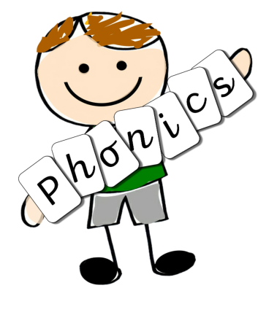

Reading and Phonics Workshop
At this workshop, we will explain more fully how we teach the children to read.
This will be held in Oak Classroom on Wednesday 23rd^{h} September at 5.00 pm.
You will be given more information about the Little Wandle Letters and Sounds scheme that we use and how we teach the lessons.
We hope that attending this session will mean that you will be more able to support your child in their reading journey.
LIVE PHONICS LESSON
Following this workshop, you will be invited to join your child in the classroom and take part in their phonics lesson.
This will take place on
Thursday 8th October at 9.00 am in Oak Class.

Slide 10
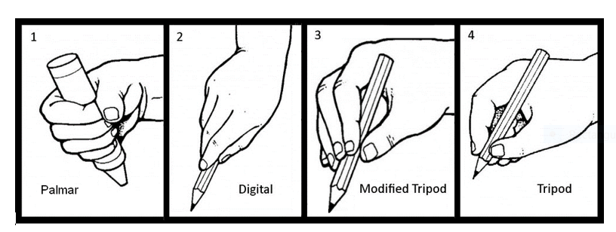
WRITING - Pencil control!
Over the next week or so, we may send home some additional work to individuals who need to help with holding and using a pencil. Please do not worry about this – this is to help your child!

Slide 11
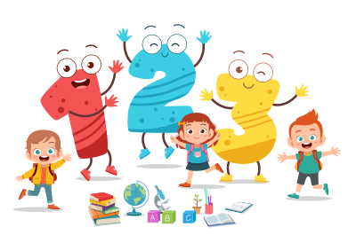
Maths
We will have our maths lessons normally in the afternoons which will involve lots of counting, singing number songs, playing games, patterns, finding shapes and investigation into length, mass and capacity.
At the beginning of each half term, you will be given a
KIRF
Key Instant Recall Facts.
These are number facts that we would like children to know by the end of the half term. We will be learning these facts in class but it would be great if they could be reinforced at home too.

Slide 12

Mrs Hill and Mrs Wilkes will lead Forest school on a Thursday afternoon.
Children should come to school wearing joggers, long-sleeved t-shirt and jumper. They should also wear trainers.
NAME EVERYTHING!
Children will need in their Forest School bag (named)
  Waterproofs, tops/bottoms/all-in-ones. –they must fit!
  Wellies
  Gardening gloves (rubberized inside)
  Spare socks
  NO scarves
  Layers for the winter
  Hat (woolly in winter/cap in summer)
  Laces are fine IF your child can do them up!

Slide 13


P.E Day
Our P.E days are Tuesday and Friday.
Kits stay in school!
Please avoid blouses and shirts on these days to help your child!
Tights are troublesome too!
No jewellery, nail varnish or tatoos at all times.

Slide 14
Rucksacks and spare clothing.
NO RUCKSACKS!
NAME EVERYTHING!
Please do not send rucksacks – we do not have the space!
Lunchboxes should not be in rucksacks. Lunchboxes should be clearly named.
Spare clothing is not required unless your child has a medical issue that has been agreed with staff.

Slide 15
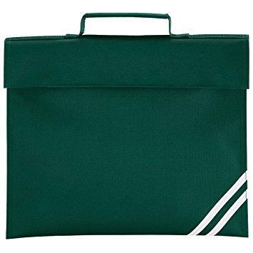
Please do not bring toys into school.
Book bag
NEEDED EVERYDAY
Check it for invites
Handouts
Pictures your child has done.
Library books
Only two keyrings attached!
Please do not
send in
Rucksacks.

Slide 16
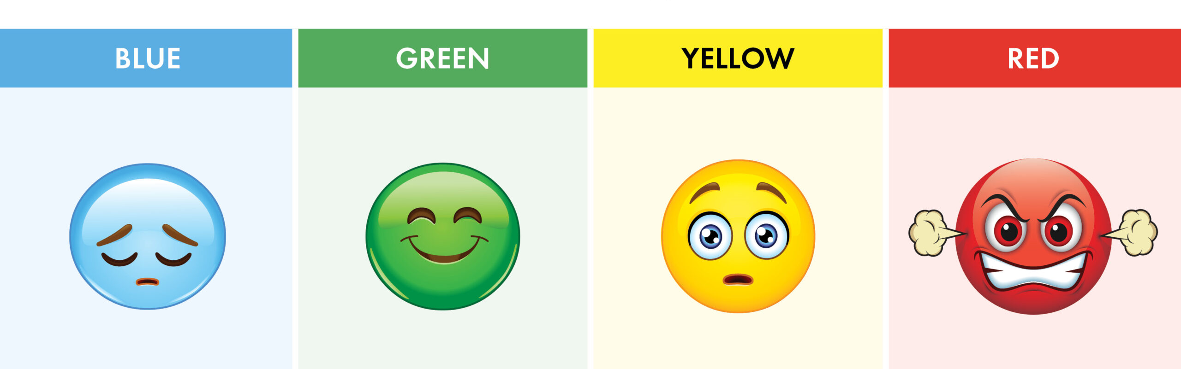
BEHAVIOUR AND CONDUCT
Our Expectations:
Kind words to each other
Kind actions to each other
Listen to adults and follow instructions
Be ready to learn.
Rewards:
We reward children with stickers, housepoints, little prizes or a visit to Mr Smith!
Outstanding actions will result in the child’s name going on the ‘Proud Cloud’.
In Oak Class, sanctions are instant.
Children will have to sit out of free play or finish work during playtime.
If further sanctions are needed, children will go to Mr Smith and parents will be spoken to.
Zone of Regulation

Slide 17
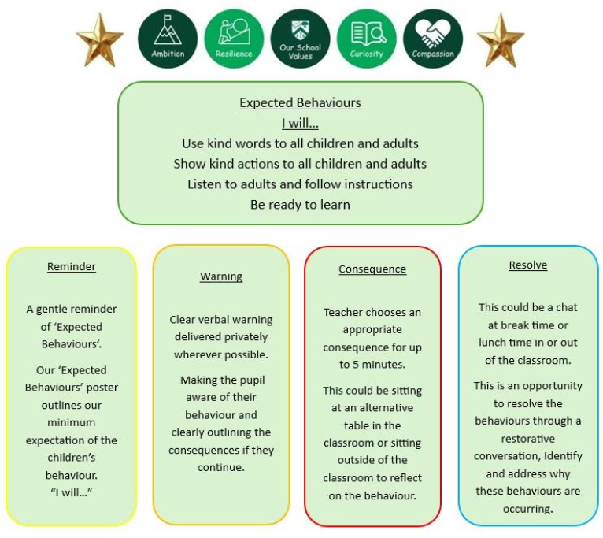

Slide 18
End of the day
Come forward so that your child can easily see you and not get lost in the crowd!
We only dismiss one at a time, this is to keep them safe.
Please wait until all children have been dismissed before you approach us to talk.

Slide 19
Reminders
Water bottles need to be in school every day; please encourage your child to drink water at home so they are happier to drink it in school. Please fill your child’s water bottle before they come to school. No juice. The children have access to water all day, we refill bottles and encourage them to drink! They have a cup of water given by school at lunch.
If your child would like to have milk at snack time, please order the milk. This is free until they are 5.
Please ensure children are suitably dressed for all weathers; we spend a lot of time outdoors. A waterproof coat with a hood everyday please. As autumn is closing in on us, a warm coat is needed every day please. Please encourage your little one to put their coats on independently and fasten them up.
Please make goodbye in the morning short and sweet!
Anybody new collecting, let us know.
Remember, if your child has an inhaler, please ensure a named inhaler is given to a member of our staff to keep in the classroom.
                NAME EVERYTHING

Slide 20
Google Classroom
You should have received a link from Google Classroom with information on how to get onto your child’s personal account. Please follow this up swiftly as this will be an important part of our communication with you! Please keep an eye out. If you have any questions, you can contact us via Google classroom – we will reply within school working hours but not when we are teaching.

Slide 21
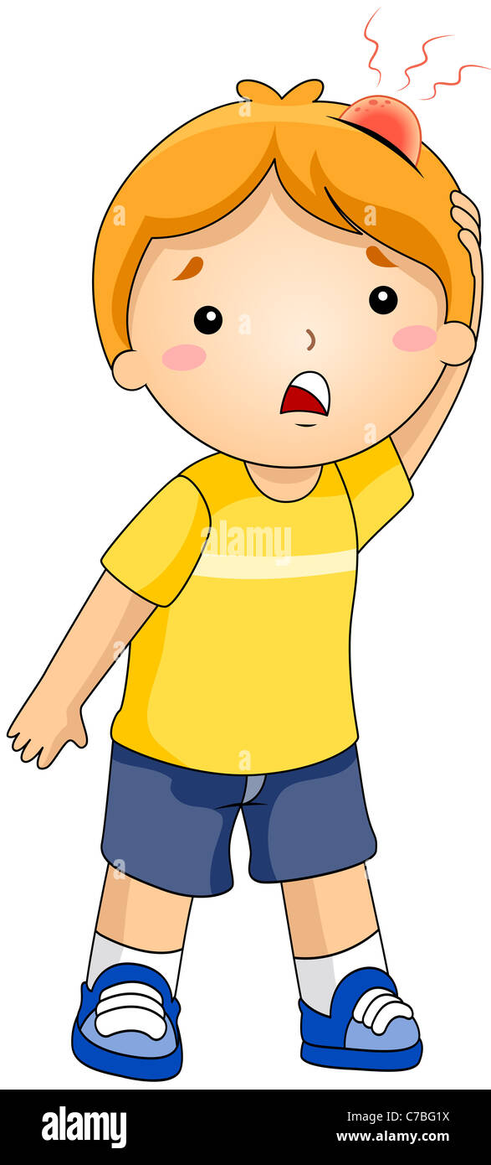
Head bump texts!
If your child has a head bump, they will be seen by a first-aider in the first instance.
You will be sent a text to inform you that your child has had a head bump.
The child will be monitored for the rest of the day and if any changes occur, you will be contacted.
If the first-aider considers the injury to be serious, we will contact you immediately.

Slide 22

Keeping up to date!
Office
School Instagram Account
GOOGLE CLASSROOM
Website
Newsletter

Slide 23
Handouts to take with you.
Autumn Term Topic Web
Maths KIRF for Autumn 1
Reading and Phonics Workshop dates
Forest School Kit (Thursdays)

Slide 24

ANY QUESTIONS?

