Slide 1

WELCOME TO
Willow Class
Year 4 Parent Information Evening
7 September 2026
Mrs Hadley • Miss Taylor
A year of learning, independence, curiosity and fun.
1

Slide 2
This evening
The key things we want you to know about Year 4
Daily life
Learning
Home support
Routines, expectations and class responsibilities
Curriculum, topics and how we assess progress
Reading, spelling, times tables and homework
PE & outdoors
Communication
PE kit, LOTC and our residential
How to keep up to date and get in touch
2

Slide 3
A typical Willow day
8:45
Children line up on the playground
12:00
Lunchtime
8:50
Assembly / morning lessons begin
Afternoon lessons begin
1:00
10:30
Break
3:15
School finishes
10:45
Lessons continue
Arrival reminder
Please stand back from the lines so children can enter safely. If your child is late, please sign them in at the office.
3

Slide 4
What do we learn in Year 4?
A broad curriculum with opportunities to think, create, investigate and perform
English
Mathematics
Science
Computing
History
Geography
Art & Design
Design & Technology
RE
Music
French
PE
PSHE
4

Slide 5
Our Year 4 journey
Six topics across the year
AUTUMN 1
AUTUMN 2
Anglo-Saxons, Picts & Scots
Where does our food come from?
What were they like compared with Britain today?
A local and global geography enquiry
SPRING 1
SPRING 2
Vikings
Madagascar
Battle tactics and their impact
What makes Madagascar so diverse?
SUMMER 1
SUMMER 2
The Tudors
Rivers & the water cycle
Why were the Tudors so important to Britain?
What is a river’s journey from source to mouth?
5

Slide 6
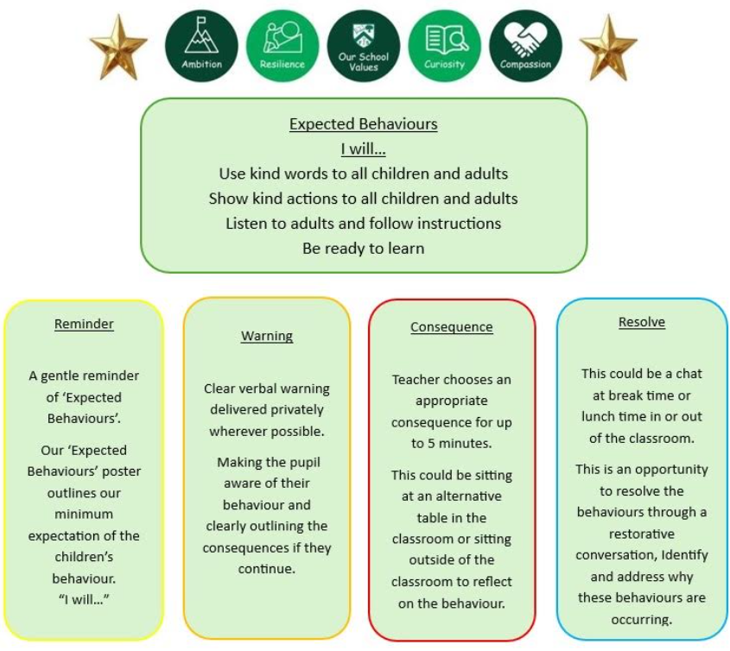
High expectations - and lots of fun
Calm, safe classrooms help children learn and thrive
Our expectations
We expect children to be respectful, ready to learn, responsible and kind. Good behaviour protects learning time and helps everyone feel safe and supported.
\
Our classroom culture
We work hard, challenge ourselves and celebrate effort - but we also laugh, create and enjoy learning together.
6

Slide 7

Helping children regulate
We use the Zones of Regulation to help children recognise and manage emotions
What we want children to learn
To recognise how they feel, choose strategies and get ready to learn.
How families can help
Use the same language at home: “Which zone are you in?” and “What might help?”
7

Slide 8

Reading in Willow Class
Building fluency, stamina, vocabulary and understanding
Accelerated Reader
At home
Books are matched to each child’s reading level. Children quiz when they finish and can change books when ready.
• Read at least 5 times each week
• Aim for a daily habit where possible
• Talk about the book, not just the number of pages
• Encourage children to choose books they enjoy
Our focus
Confident, fluent reading - with a strong understanding of what has been read.
8

Slide 9

READING AT HOME
10–15 minutes can make a real difference.
Regular reading supports vocabulary, confidence and attainment - and strong reading skills open doors far beyond primary school.
READ
TALK
ENJOY
A story, comic, magazine or non-fiction book.
Ask “What do you think?” “Why?” “What might happen next?”
Let children see adults enjoying reading too.
Read • Talk • Enjoy • Repeat
9

Slide 10

Spelling
Short, regular practice rather than long sessions
In school
At home
Regular ‘bite-sized’ activities using spelling patterns and Year 4 curriculum words.
Weekly focus words and patterns will be shared. Children can use their Ed Shed log-ins.
Home sheet will come to be completed by the following week. A Homework Club will run on Mondays at 12pm.
The aim
Regular revisiting so children remember spellings securely and can use them accurately in their writing.
10

Slide 11

Assessment
A picture of progress — not a single test
Everyday assessment
Formal checks
Questioning, discussion, marking, observation and feedback happen throughout lessons.
Where appropriate, children complete tests or assessments to help us identify what they know and what they need next.
What we use assessment for
To celebrate progress, identify gaps, adapt teaching and make sure children receive the support or challenge they need.
11

Slide 12
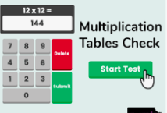
Times tables & the Year 4 check
Fluent recall makes later mathematics much easier
The check
When?
25 questions on-screen, with 6 seconds per question. It takes around 5 minutes.
The 2027 check window is 7–18 June 2027.
What you can do
Short, frequent practice of multiplication and division facts up to 12 × 12. We will practise as part of normal learning.
12

Slide 13
Homework: purposeful, manageable and creative
We want children to have time outside school to play, explore, relax and be with family.
A good balance
Our approach
• Regular reading, times tables / number facts and spelling practice.
• A termly or half-termly topic project, where children can follow their own interests.
• Learning can happen naturally through cooking, experiments, outdoor play, hobbies and conversations.
Home learning should support school learning without taking over family time.
13

Slide 14
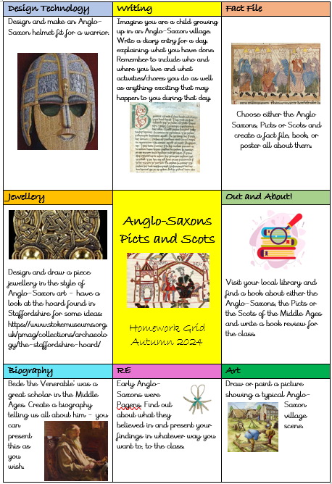
Homework this half-term: Anglo-Saxons, Picts & Scots
Choose one project and make it your own
Open-ended
Creative
Children can choose a project that matches their interests and strengths.
Model, artwork, research, presentation, writing - the choice is theirs.
Celebration
Projects are brought in before the end of the half-term and showcased in class.
14

Slide 15
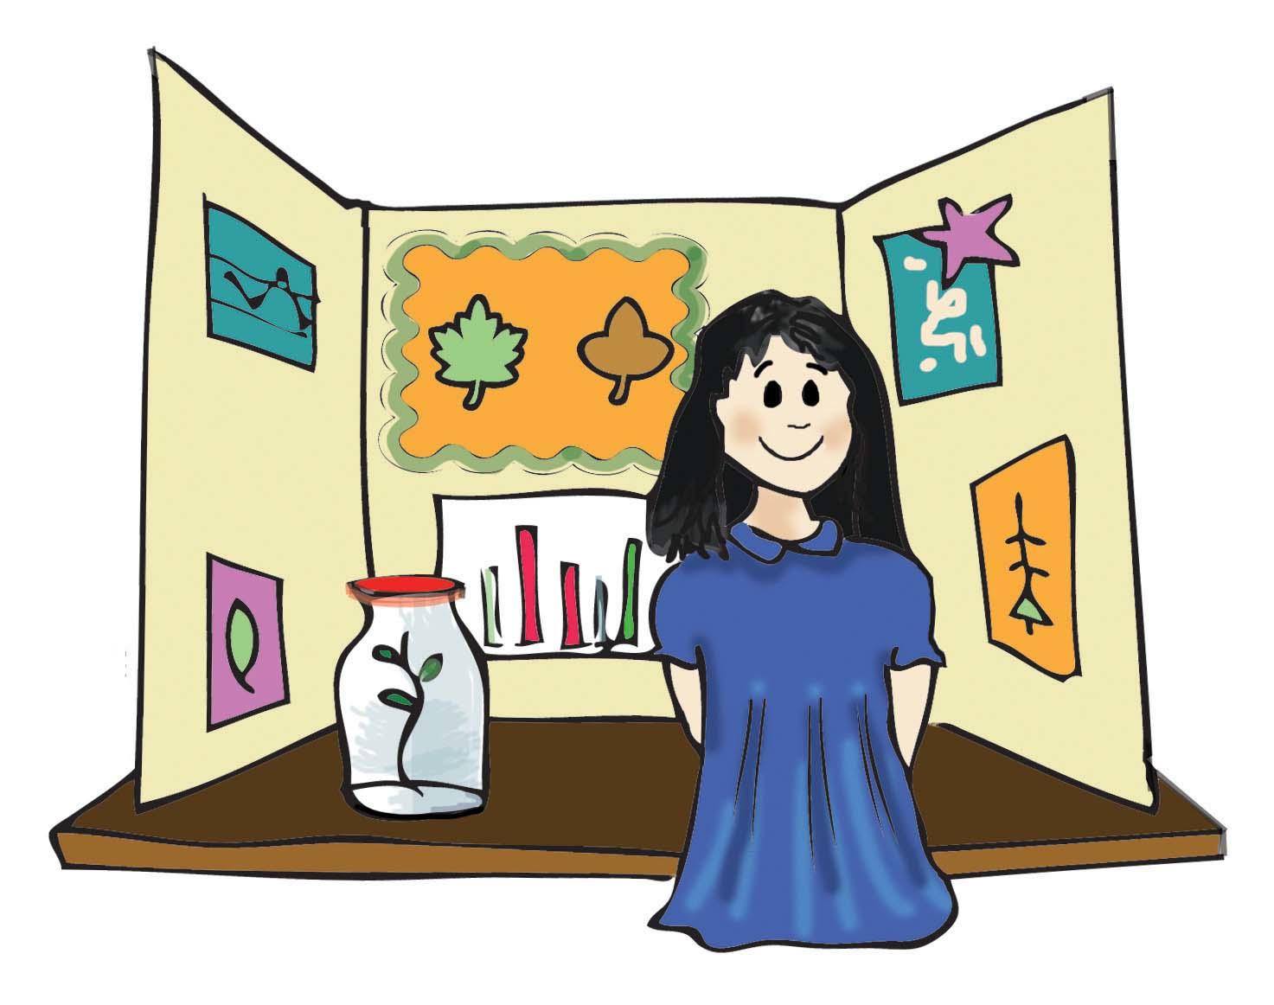
Growing independence
Year 4 is about becoming increasingly responsible and confident
Class jobs
Children apply for roles and usually keep them for a term. Jobs build responsibility and prepare children for middle school and beyond.
Interest Board
Each week, one child shares a hobby or interest with the class. There is no set formula - children choose how to present it.
15

Slide 16

PE & physical activity
This term: Wednesday and Thursday afternoons
Kit
Ready to learn
Please have indoor and outdoor kit plus pumps/trainers.
Long hair tied back; no jewellery or hairbands. Earrings covered or removed.
Keeping active
We will aim to do the Daily Mile as often as possible. Please keep trainers in school every day.
16

Slide 17
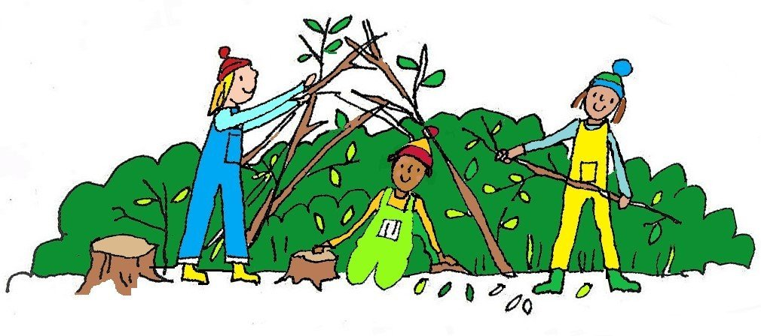
Learning Outside the Classroom
LOTC with Mrs Hadley and Miss Taylor — normally on Mondays
Come prepared
Kit
Outdoor clothes: long sleeves and long trousers, with extra layers, waterproofs, hat, gloves and wellies as needed.
Label everything. Children put kit in outdoor lockers before school and take it home afterwards.
Expect mud!
A spare set of clothes is a good idea. Children may sometimes be asked to source a simple item independently for an activity.
17

Slide 18
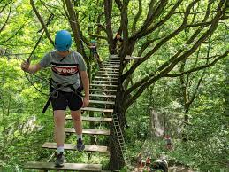
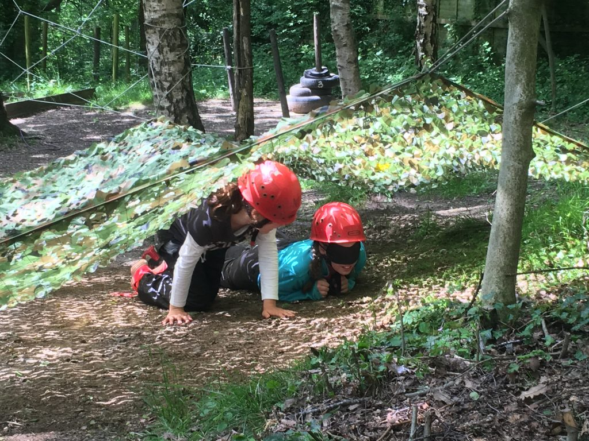
Looking ahead: Bell Heath
Our Year 4 residential
10–12 March 2027
2 nights • 3 days • lots of opportunities to build confidence and independence
18

Slide 19
A few important reminders
If your child is late
Collection arrangements
Please bring them to the office to be signed in.
If someone different is collecting your child, staff must be informed before we release them.
Keep everything labelled
Changes
PE kit, LOTC kit, trainers and other belongings should be clearly named.
If an LOTC day changes, we will let you know beforehand.
19

Slide 20

Keeping up to date
We want communication between home and school to be easy and positive
Instagram
Newsletter
School updates and highlights
Whole-school information
Website
Google Classroom / Emails
Curriculum → Classes → Willow Class
Learning and direct communication
Texts
Important school messages
Please ask if you are unsure where to find something.
20

Slide 21
WE ARE A TEAM
School + home = the best support for your child.
We pride ourselves on being approachable. If you have a question, concern or worry, please talk to us early so we can work together.
Ask
Share
Work together
No question is too small.
Tell us what helps your child.
We all want the same thing: happy, successful children.
21

Slide 22

THANK YOU
Any questions?
We are looking forward to a fantastic year in Willow Class.
Mrs Hadley & Miss Taylor
22

