Slide 1

Welcome to Willow Class
Parent Curriculum Information Evening
8th September 2025
Mrs Hadley and
Miss Taylor

Slide 2
Daily Routine
8:45 AM
Children line up on playground
8:50 AM
Assembly/Morning Lessons start
10:30 AM
Break starts
10:45 AM
Break finishes
12:00 PM
Lunchtime
1:00 PM
Afternoon lessons begin
3:15 PM
School finishes
Notes:
Remind parents to stand back from lines to allow the children to enter school.
Gate is open at bottom if wuick exit is required.

Slide 3
In Willow Class (KS2),
we learn the following subjects:
English
Mathematics
Science
Computing
History
Geography
Art and Design
Design and Technology
RE
Music
Modern Foreign Languages (French)
PE
PSHE

Slide 4
This year our topics are…
Autumn 1 – What was Anglo-Saxon, Pict and the Scots like compared to Britain today?
Autumn 2 – Local Study
Spring 1 – What were the Viking battle tactics and what impact did they have?
Spring 2 – What makes Madagascar so diverse?
Summer 1 – Why were the Tudors so important to Britain?
Summer 2 – Rivers and the Water Cycle - What is the river’s journey from source to mouth?

Slide 5
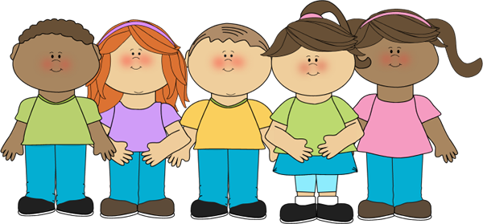
Formality and Fun
We have very high expectations in Willow Class.
Good behaviour in schools is central to a good education. We need to manage behaviour well so we can provide calm, orderly, safe and supportive environments in which our children want to attend and can learn and thrive. Being taught how to behave well is vital for children to succeed personally and for them to successfully navigate the communities they inhabit.

Slide 6
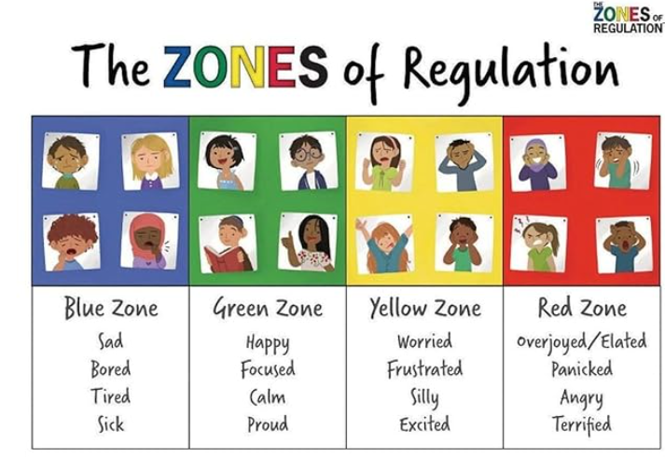

Slide 7
Although we have high expectations and we work hard we also have lots of fun!
As the year progresses, we will be creative in show-casing our wonderful work at Open Classroom Events.

Slide 8

Reading books….
Your child will be bringing home a reading book every day that is matched to their reading fluency and comprehension through the Accelerated Reading Scheme.
They will have an opportunity to change their books whenever they want after completing a short quiz online about the book they have just read. These quizzes constantly add to your child’s reading profile and contribute to your child’s ZPD (the choice of books matched to your child’s reading level.)
We expect children to read at least 5 times a week at home but try to encourage them to get into the habit of reading every day if possible.
We are looking for confident, fluent reading but also an understanding of what they are reading.
Accelerated Reader has been proven to motivate children to read more through engaging quizzes, goal setting, and personalized recommendations. As children increase their reading volume, they develop greater reading stamina, word recognition, and language comprehension skills.

Slide 9


Research…
The benefits of reading…
From babies to children in their early years and all the way through to early teens, reading brings profound and wide-ranging benefits that can have a lifelong positive impact on children’s lives.
Book Trust 2024

Slide 10
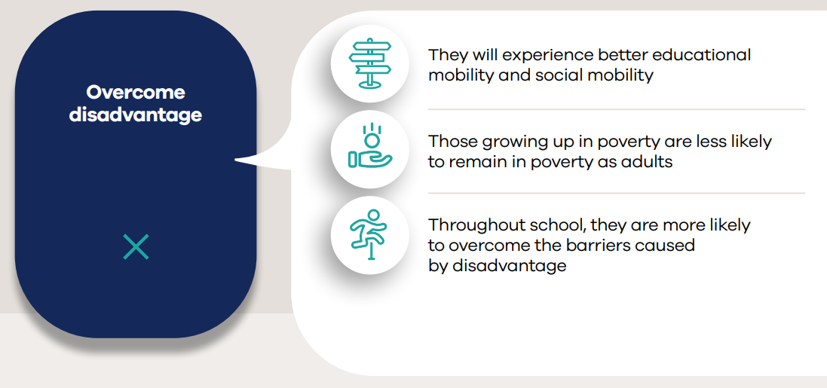

Slide 11
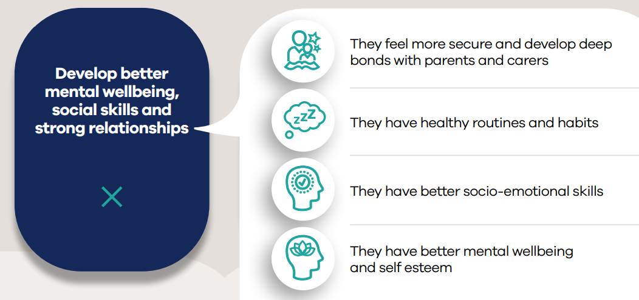

Slide 12
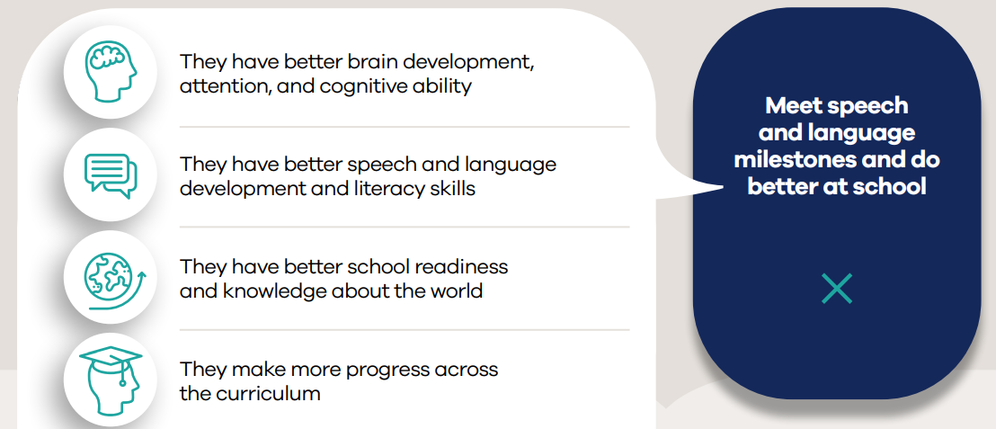

Slide 13
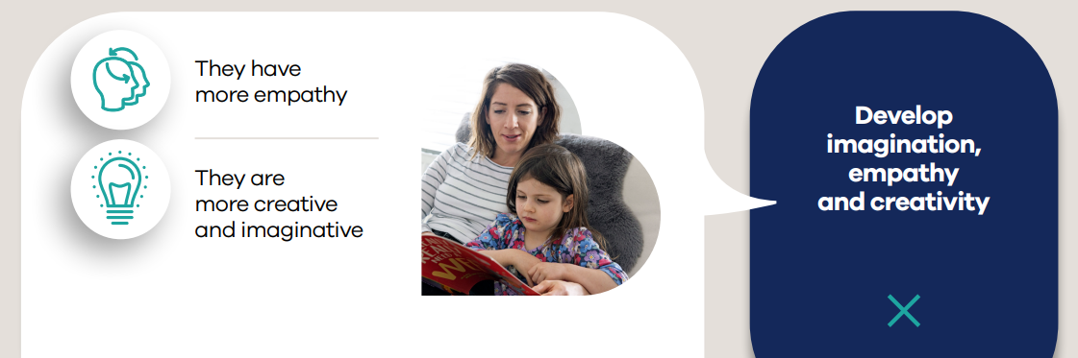
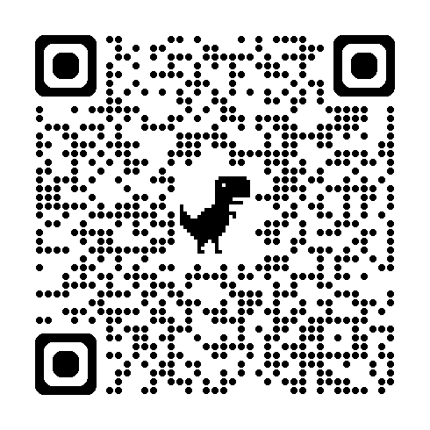
For further information or to see reference material please scan the QR Code.

Slide 14

Spelling
We will be teaching spelling in school through spelling patterns and using the curriculum year group spelling lists.
Our spelling sessions will be daily ‘bite sized’ activities that will be fun and interactive using Spelling Shed resources.
We will assess children’s understanding of spellings every week through a variety of methods and therefore will be sending home examples of the spelling patterns and words currently being focused on.
I have put together a booklet with lots of different strategies for the children to use at home (Website and GC)
Spelling is an on-going activity, and children will be encouraged to constantly revisit previous spellings to ensure depth of learning.
Children can access their spellings and online resources through their Ed Shed Log-ins.

Slide 15

Assessment
This will be managed through
a range of informal and formal tests, alongside constant teacher
assessment.

Slide 16
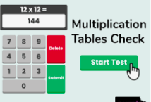
The Multiplication Tables Check will take place in the 2-week period from Monday 1 June 2026.
Guidance found on Willow Class web page.

Slide 17
Multiplication Tables Check
Your child will be participating in the multiplication tables check in June. The purpose of the check is to determine whether your child can fluently recall their times tables up to 12, which is essential for future success in mathematics. It will also help us identify if your child may need additional support.
What is the Multiplication tables check? It is an on-screen check consisting of 25 times table questions. Your child will be able to answer 3 practice questions before taking the actual check. They will then have 6 seconds to answer each question. On average, the check should take no longer than 5 minutes to complete.
What if my child cannot access the check? There are several access arrangements available for the check, these can be used to support pupils with specific needs. If you have any concerns about your child accessing the check, you should discuss this with your child’s teacher.
Do I need to do anything to prepare my child for the check? No, you do not need to do anything additional to prepare your child for the check. As part of usual practice, we will ask you to practise times tables with your child. We will have unlimited access to a 'try it out area' from March. We can use this to make sure pupils have the necessary support required to access the check. This includes opportunities for pupils to familiarise themselves with the check application and try out any access arrangements that may be required.
How will the results be used? We will have access to all our pupils’ results, allowing those pupils who need additional support to be identified.
Will I receive feedback on my child’s check? Yes. Your child’s teacher will share your child’s score with you, as they would with all national curriculum assessments. There was no pass mark for the check this year, but that may change.
Taken from: Information for parents: 2023 multiplication tables check.

Slide 18
Homework
We want our children to spend their time out of school playing, exploring and getting recharged for the next day – being children!
Traditional homework limits valuable family time, and may even be detrimental to students’ mental health, whereas playing and exploring is greatly beneficial for this.
Our policy gives families the freedom to let their interests and passions guide their learning. Science experiments, playing outside, cooking and reading books together become an equally important part of a child’s development, along with the curriculum they learn at school.
It is still expected that you will support your child’s learning through nightly reading, times table/number bonds practice and practising spelling words etc.
Children will also have the option to complete a termly/half-termly topic project, which will then be showcased to parents at the end of each term.

Slide 19
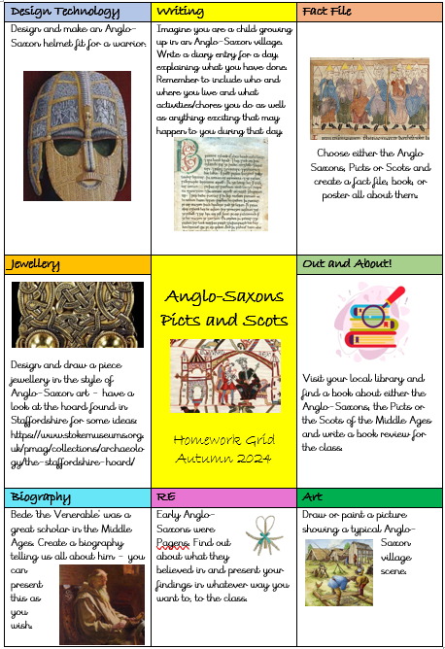
Homework
This half-term, our topic is the Anglo-Saxons, Picts and Scots. Our homework project is open-ended, enabling your child to be creative in a way that they enjoy. They can choose one of these projects, which should be in just before the end of half-term, where they will be showcased and celebrated.

Slide 20
Class Jobs
Your child has been allocated jobs within the class or school, which they applied to do. They mostly keep these jobs for a term.
Most are performed through the normal routine of the day, but the Fruit and Milk Monitors are expected to come in before school at 8.30am to deliver the fruit and milk to the different classes.
These jobs give them a sense of responsibility and help them prepare for middle school and beyond.

Slide 21
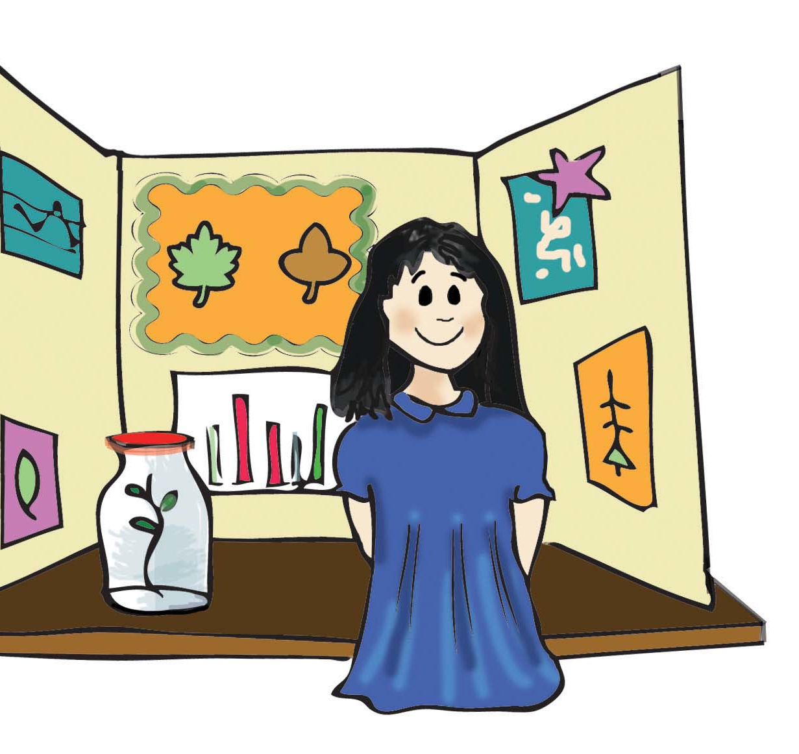
Interest Board
Every week, as in Year 3, one of your children will have the opportunity to share an interest or hobby of their choice with their peers.
This is usually displayed and presented on a Friday afternoon.
The children can choose how they share their interest with the class – there is no set formula!

Slide 22
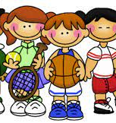
PE
Wednesday and Thursdays are our PE afternoon this term.
Please ensure children have indoor and outdoor pumps/trainers.
Long hair should be tied up, no hairbands or jewellery. Earrings should be covered or removed.
We have several festivals coming up over the year: football, netball, hockey, rugby and cricket.
We will try and do the Daily Mile as many days as possible – please have trainers in school every day.

Slide 23
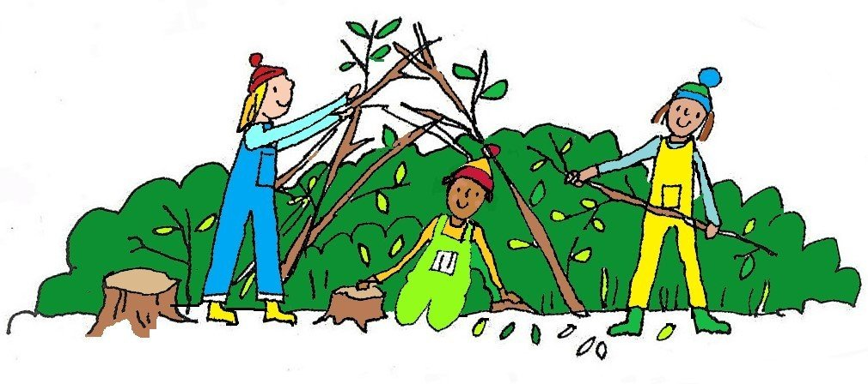
Learning Outside the Classroom
LOTC sessions will be every Monday afternoon with Mrs Hadley and Miss Taylor.
If the day changes you will be notified beforehand.
Children are to come to school in their outdoor clothes (long sleeved tops and long trousers) on Mondays.
Please remember extra layers, waterproof clothing, gloves, hats and wellies. Long hair should be tied up, no hairbands or jewellery. Earrings should be covered
All kit should be clearly labelled.
Children should put their kit in the outdoor lockers before school and take their kit home at the end of the day.
Children may sometimes be asked to source an item for an LOTC activity independently.
If your child likes getting muddy, then a spare set of clothes is advisable to change into before home.

Slide 24
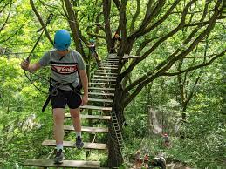
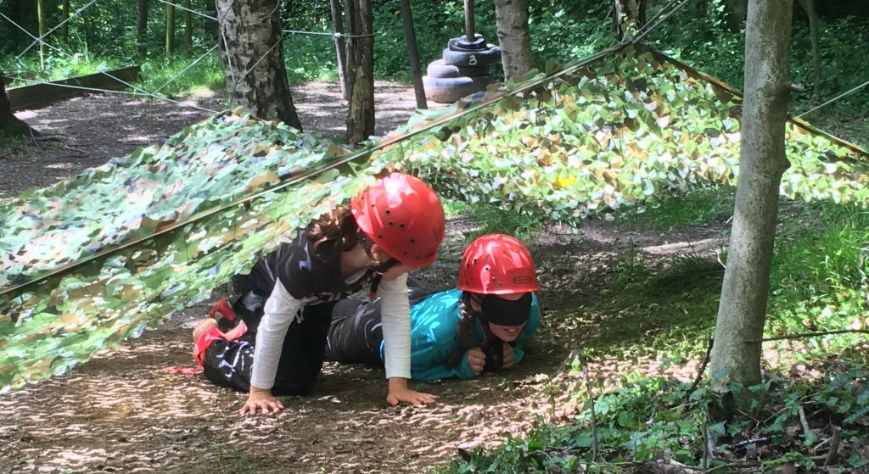
Bell Heath
Next year - March 18-20^{th –} (2 nights and 3 days)

Slide 25
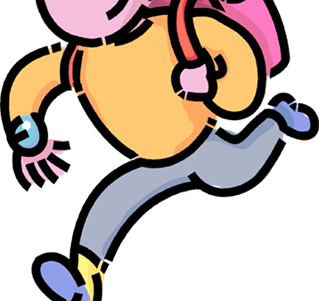
Late for school…
Please don’t forget that if your child is late for school, bring them to the office to be signed in.
If your child is going to be collected by somebody different, staff MUST be informed before we will release your child – this can be verbally face to face, a phone call or email.

Slide 26

Keep up to date with school life…
X
Newsletter
Website – Curriculum – Classes -Willow Class
Google Classroom/Emails
Texts

Slide 27
We pride ourselves on good communication and being approachable. We encourage you to let us know any questions, concerns or worries you may have.
Any Questions?

Slide 28

Mrs Hadley and Miss Taylor

